Slide 1
Inferring phytoplankton host-virus traits and trade-offs from laboratory population dynamics
David Talmy
Weizmann Institute, Aug 2019

Slide 2
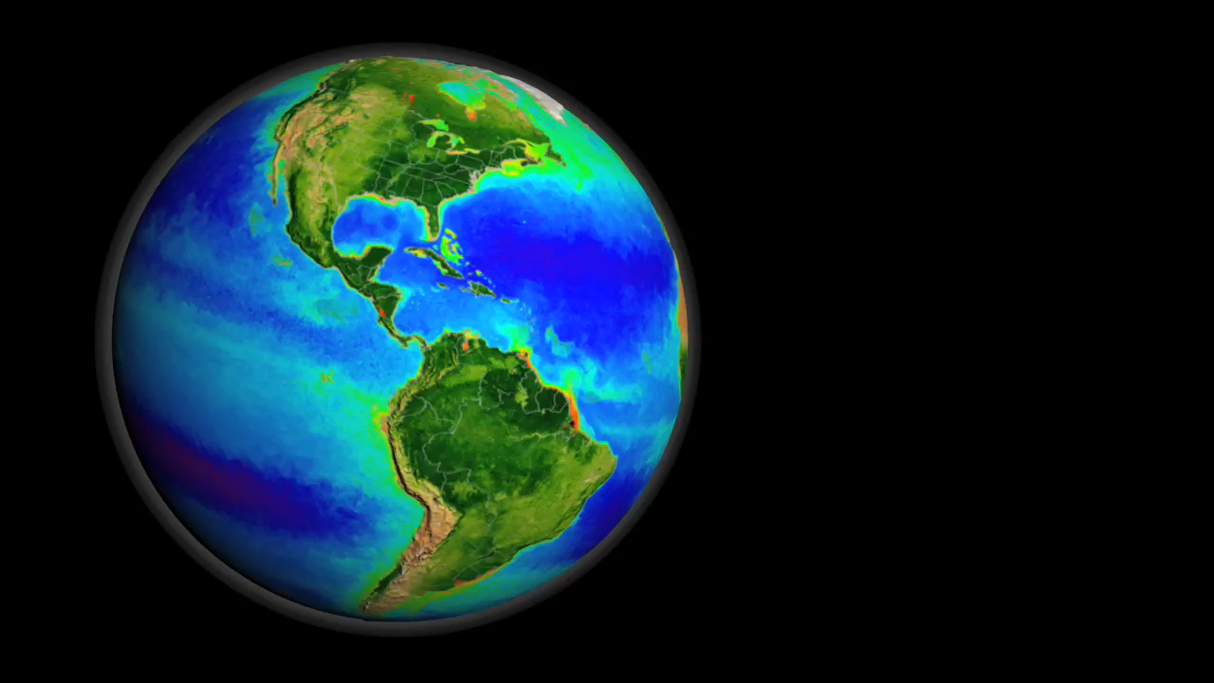
False color chlorophyll from SeaWiFS satellite
(https://svs.gsfc.nasa.gov/3450)

Slide 3
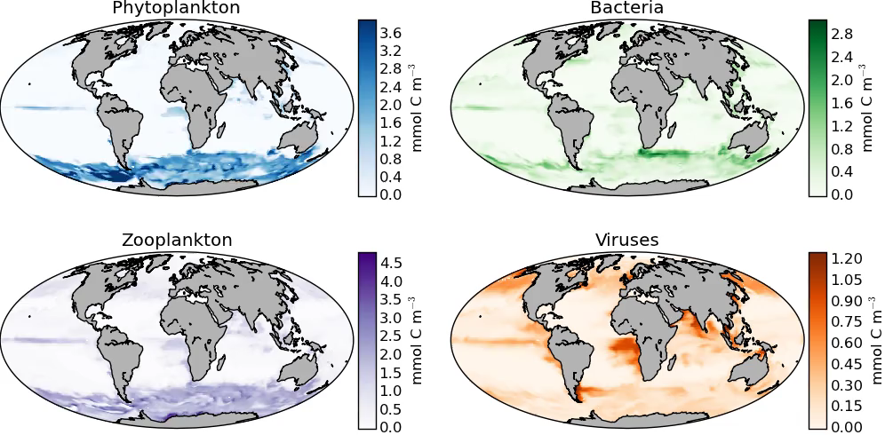
Modeled biomass (Darwin model), looping over a seasonal cycle

Slide 4
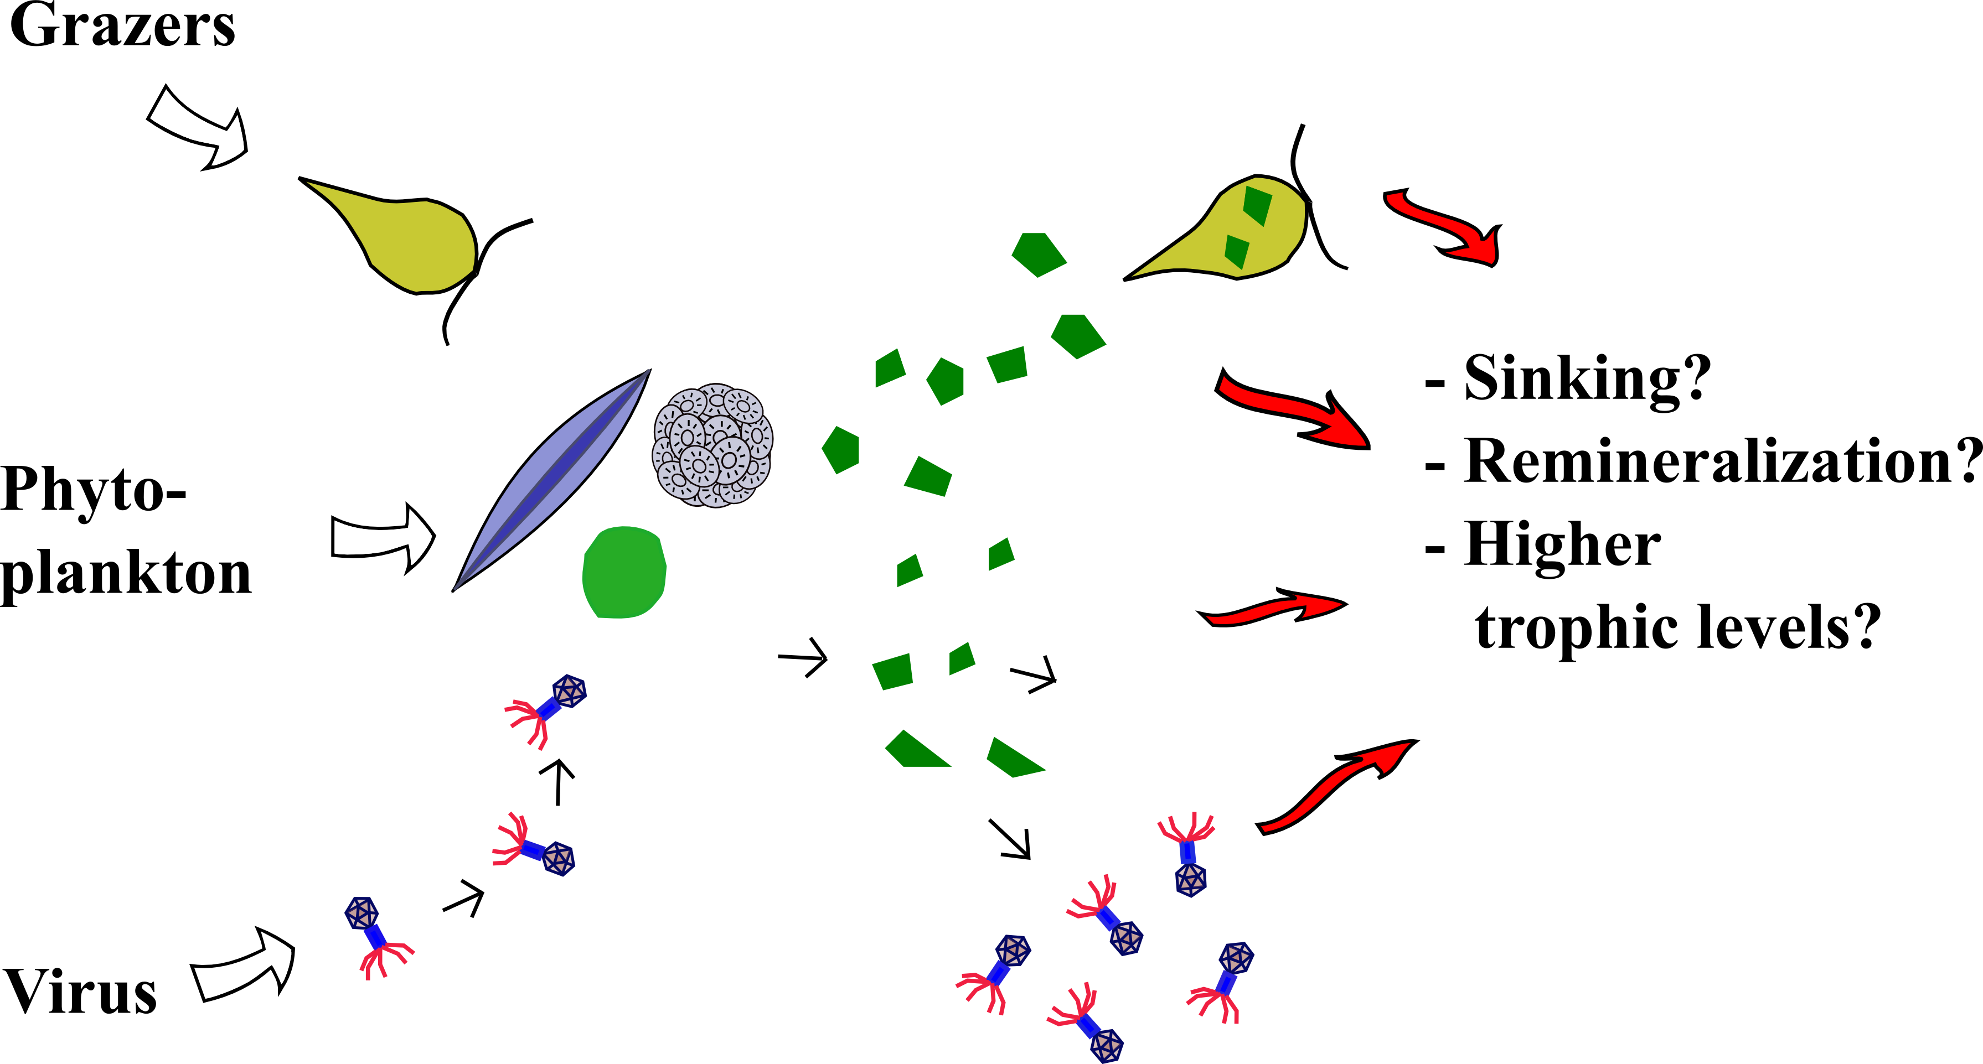
Overarching motivation – how do viruses influence ecosystem carbon and nutrient pathways?

Slide 5
Three stages of lytic infection
i) Adsorption
& entry
ii) Viral replication
iii) Lysis
Susceptible host
Infected host
Aim: Capture these three stages quantitatively within ecosystem models

Slide 6
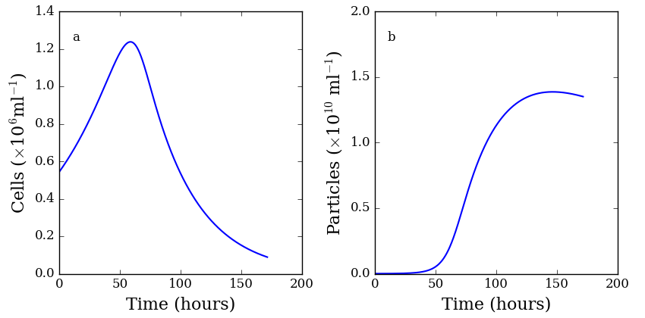
Signatures in host-virus population dynamics
2
1
3
4
infection
Factors influencing population dynamics
1) host metabolism
2) adsorption, entry, and initial replication
3) host lysis
4) efficiency (yield) of viral replication
Key parameters
μ – host growth rate
Φ – ‘transfer’
3) λ – lysis rate
4) β – burst size

Slide 7
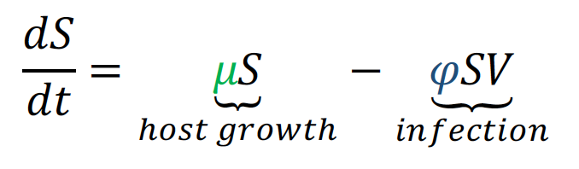
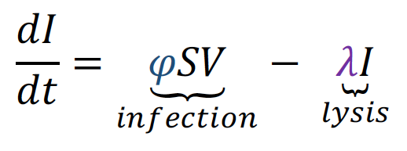
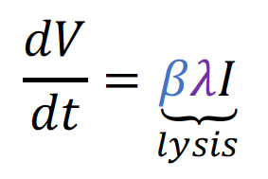
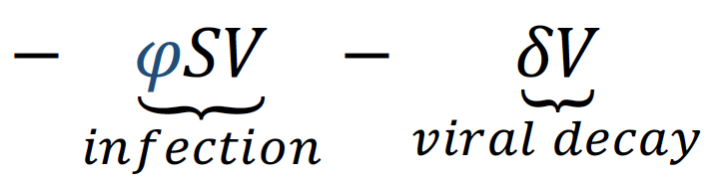
(S – ‘susceptible’ hosts)
Model of infection dynamics
(I – infected hosts)
(V – free virus)
Key parameters
μ – host growth rate (day⁻¹)
Φ – transfer affinity (ml virus⁻¹ day⁻¹)
3) λ – lysis rate (day⁻¹)
4) β – burst size (viruses host⁻¹)

Slide 8
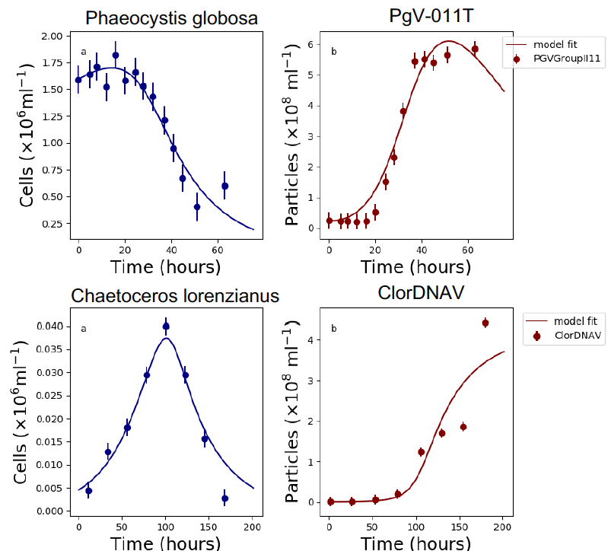
One model (with different fitted parameters) captures diverse population dynamics
Data: Baudoux et al., 2005; Tomaru et al., 2011 Model fitting: Hinson, UTK postdoc

Slide 9
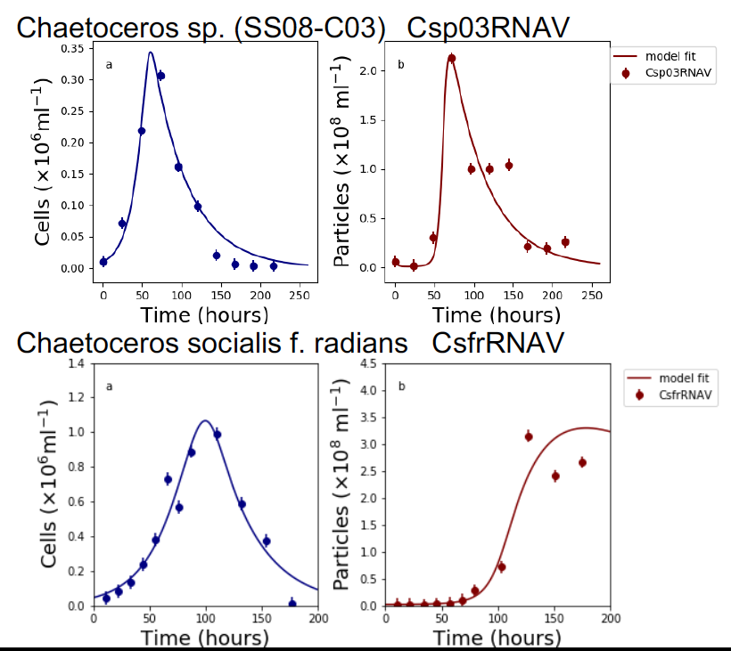
Diverse population dynamics, even within the same genus
Data: Tomaru et al., 2009, 2013 Model fitting: Hinson, UTK postdoc

Slide 10
Questions
Can patterns in the parameters that underlie these fits give guidance on the presence of key traits and trade-offs:
In populations exposed to different abiotic conditions
In diverse algal groups

Slide 11
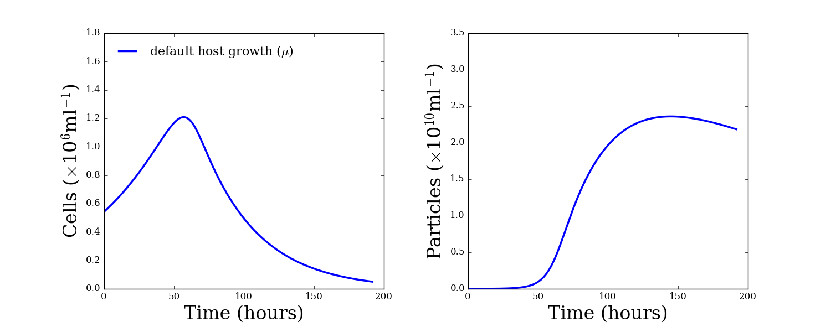
Potential for interacting / compensating effects of different parameters
‘cells’ = ‘susceptible’ (S) + ‘infected’ (I)

Slide 12
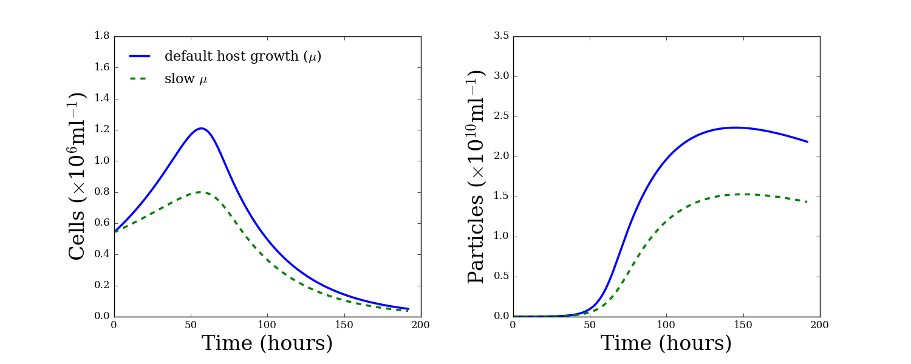
Potential for interacting / compensating effects of different parameters
‘cells’ = ‘susceptible’ (S) + ‘infected’ (I)

Slide 13
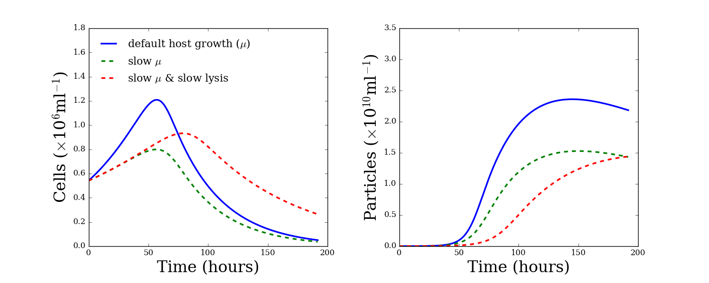
Potential for interacting / compensating effects of different parameters
‘cells’ = ‘susceptible’ (S) + ‘infected’ (I)

Slide 14
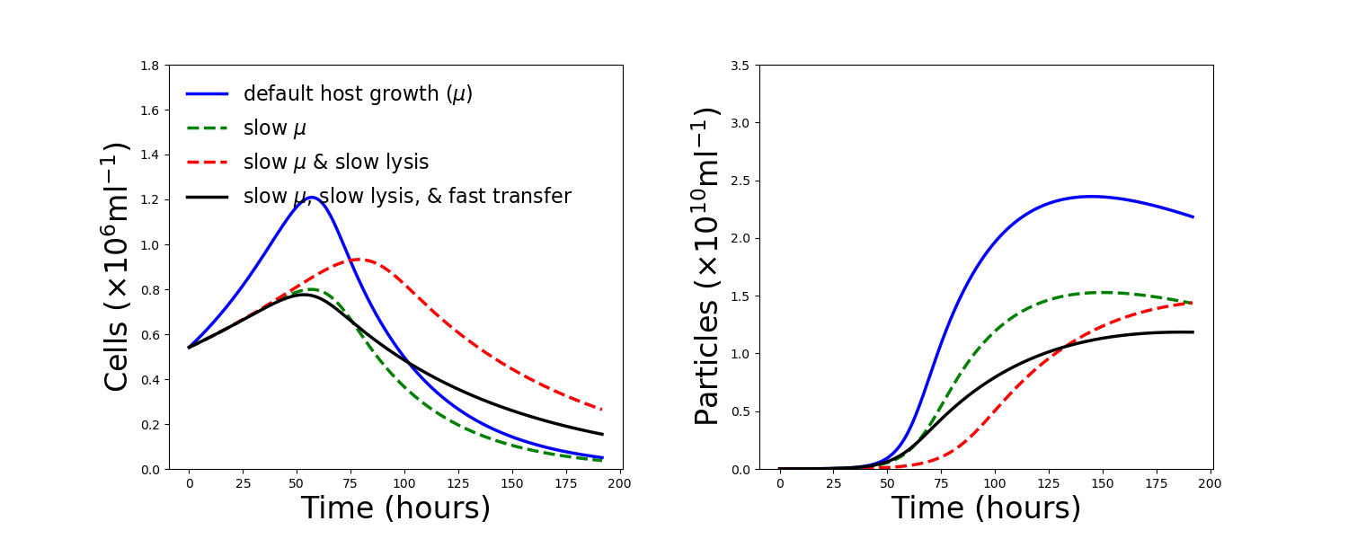
Potential for interacting / compensating effects of different parameters
‘cells’ = ‘susceptible’ (S) + ‘infected’ (I)

Slide 15
Experimental procedure:
Fit the model to laboratory population time-series
Repeat under different abiotic conditions
In an inverse manner, look for differences in fitted parameters

Slide 16
Case studies
Three host-virus systems, mutiple manipulations:
Chaetoceros tenuissimus - CtenDNAV under Fe limitation (Kranzler & Thamatrakoln)
Emiliania huxleyi – EhV under light limitation (Thamatrakoln et al., 2018)
Micromonus pusilla – N and P limitation (Maat et al., 2016)

Slide 17
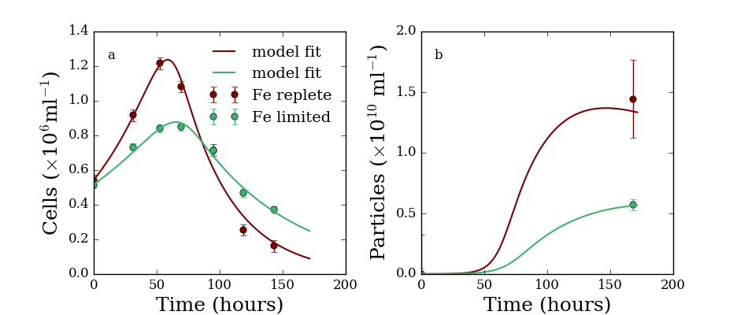
Part 1:
Fe limitation alters Chaetoceros tenuissimus - CtenDNAV population dynamics

Slide 18
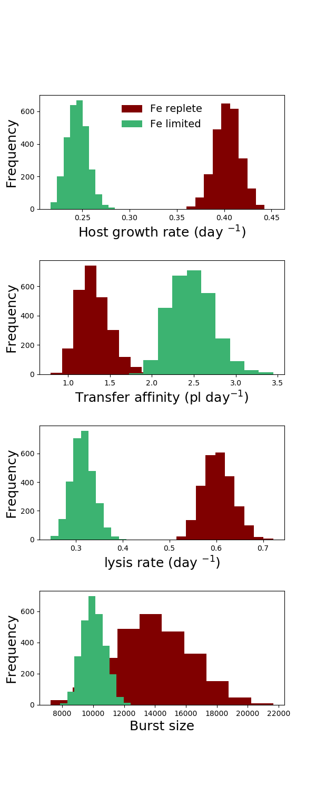
μ – host growth rate
Φ – transfer affinity
λ – lysis rate
β – burst size

Slide 19
What does the model add?
Fe limitation:
slows Chaetoceros tenuissimus metabolism (μ)
slows down host lysis (λ)
reduces CtenDNAV yield (burst size) (β)
speeds up combined effects of adsorption, entry initial infection (transfer, Φ)?

Slide 20
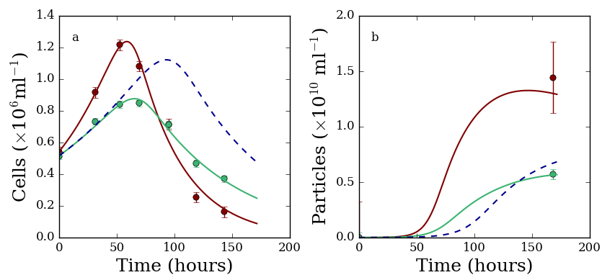
Φ subtly influences population dynamics
μ, λ, β from Fe limited, change in Φ ignored

Slide 21
Part 2: light dependence of E. huxleyi-EhV infection

Slide 22
Manipulative light experiments with E. huxleyi-EhV
1) 14 hours of light then darkness
+ EhV
2) 14:10 L:D cycle
+ EhV
Thamatrakoln, Talmy et al., New Phytologist, 2018

Slide 23
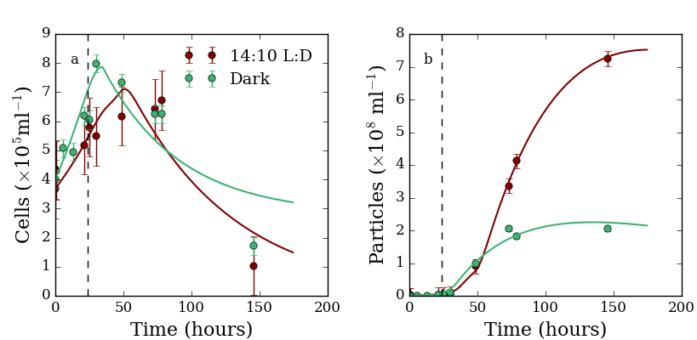
Light limitation alters E. huxleyi- EhV population dynamics

Slide 24
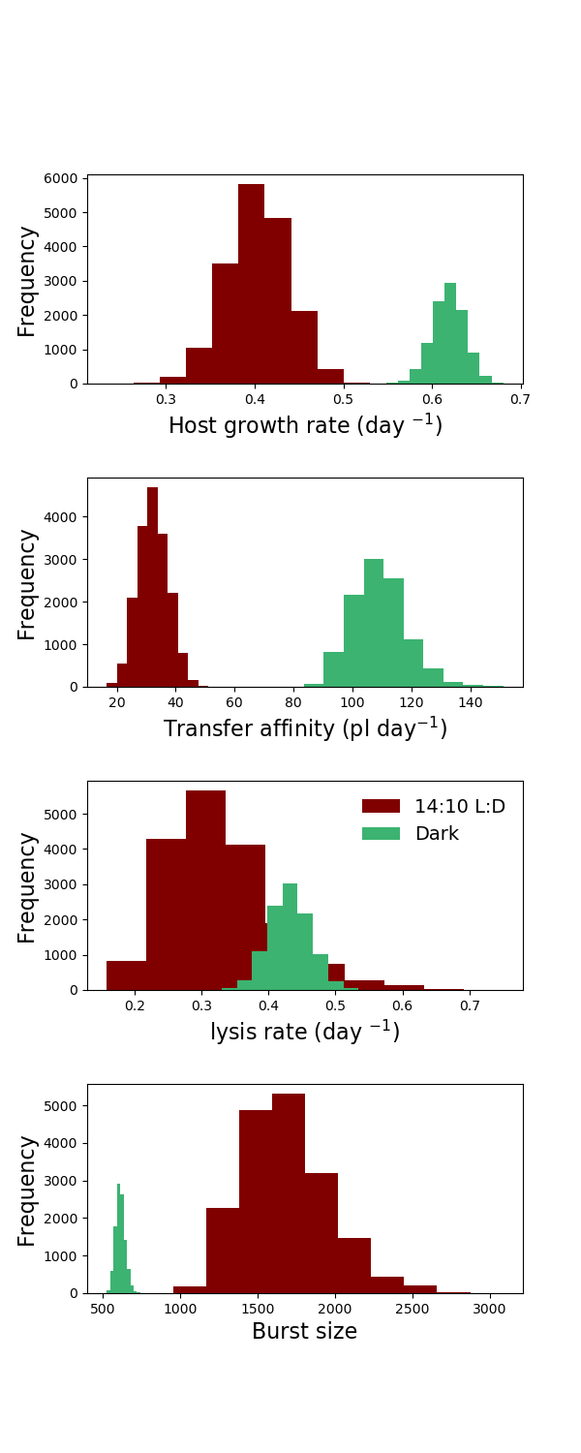
μ – host growth rate (in the light)
Φ – clearance rate
λ – lysis rate
β – burst size

Slide 25
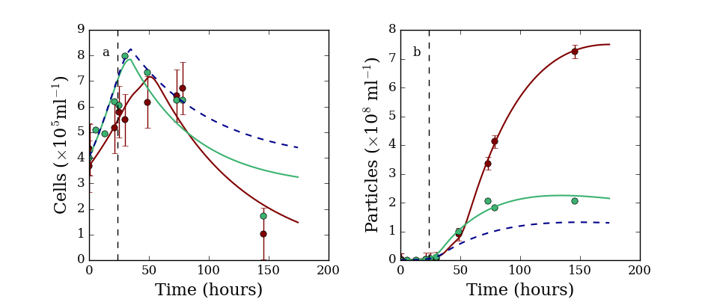
ignoring Φ has a big impact on population dynamics
μ, λ, β from light limited, change in Φ ignored

Slide 26
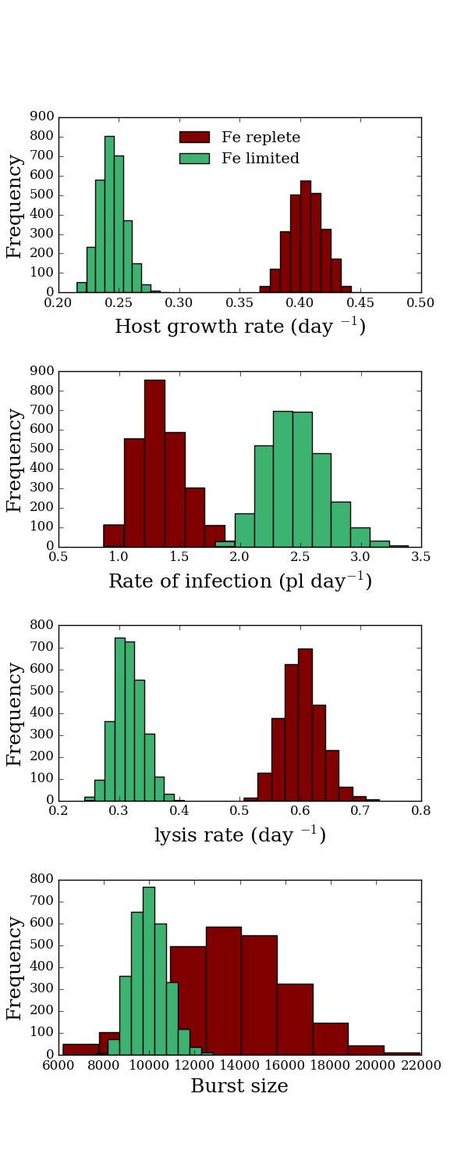
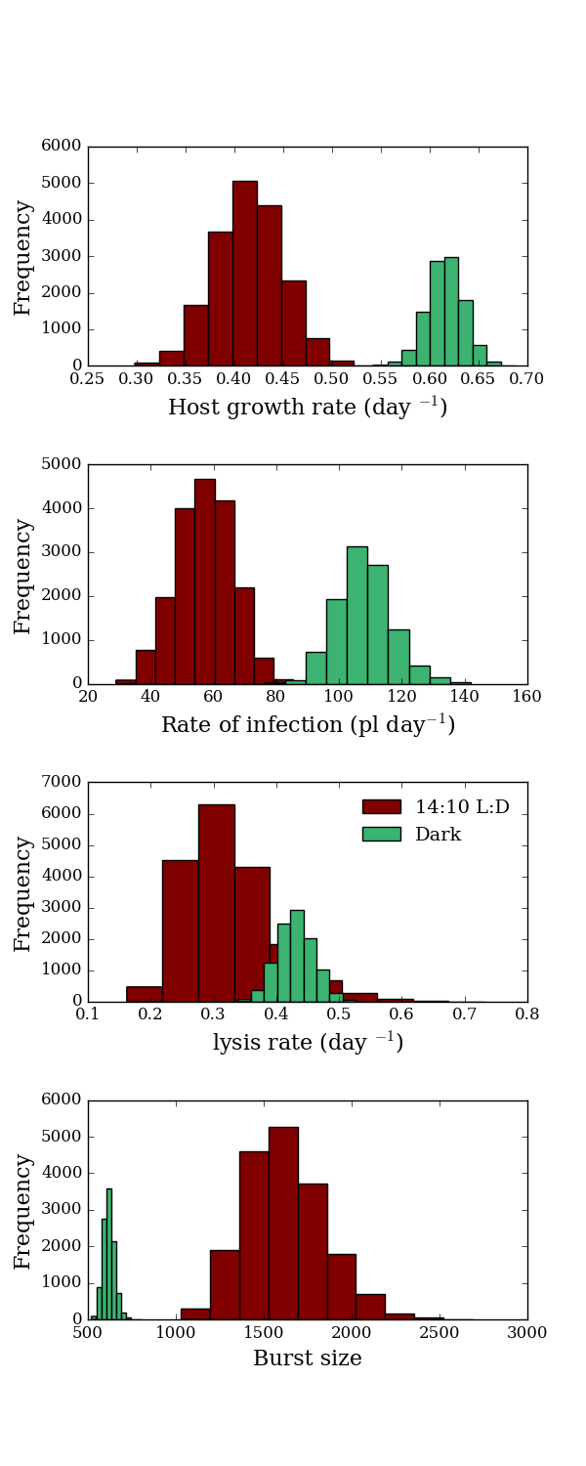
Simple model captures infection dynamics in different host-virus systems (diatom and coccolithophore)
‘Transfer affinity’ is higher in both Fe limitation and darkness
Φ, Diatom Fe manipulations
Φ, Cocco light manipulations

Slide 27
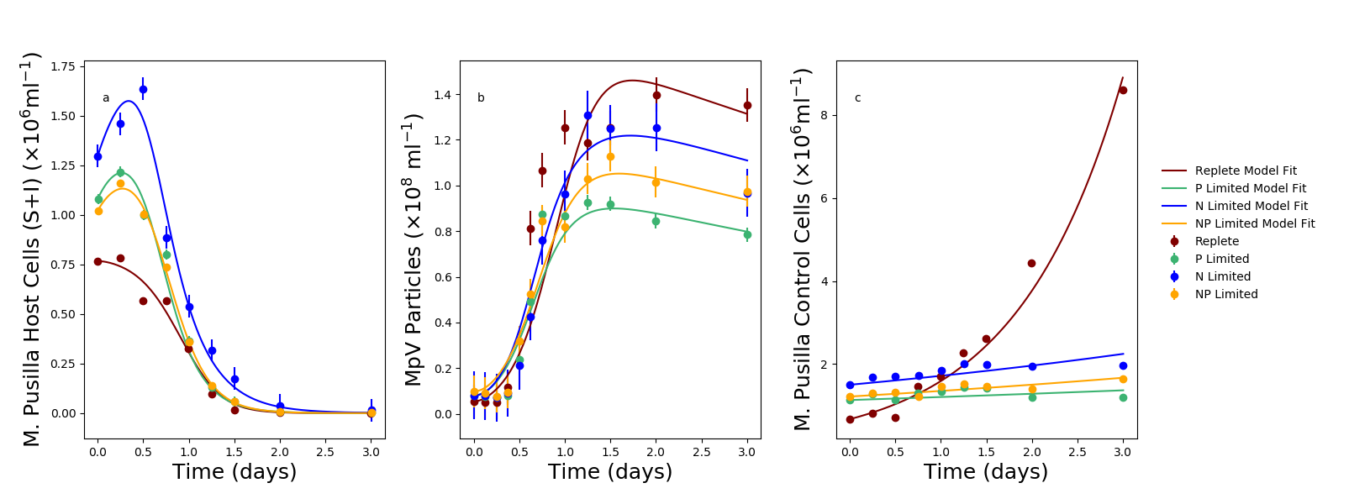
Similar patterns in M. pusilla under N and P limitation (Maat et al., 2016)
Margie Knight, Priscilla Chao, Lucas Fiet, NSF Research Experiences for Undergraduates, UTK 2019

Slide 28
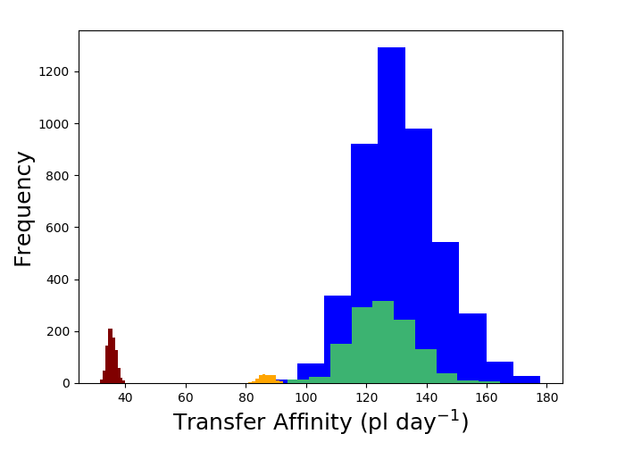
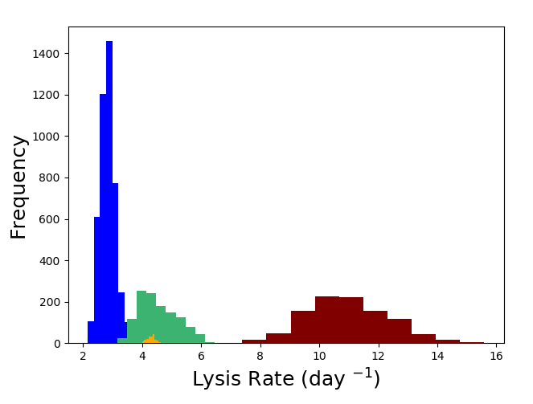
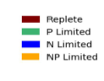
Similar patterns in M. pusilla under N and P limitation (Maat et al., 2016)
Nutrient limitation elevates the transfer affinity, but reduces the rate of cell lysis

Slide 29
Are there patterns in traits that underlie population dynamics across diverse algal groups?

Slide 30
One model (with different fitted parameters) captures diverse population dynamics
Data: Baudoux et al., 2005; Tomaru et al., 2011 Model fitting: Hinson, UTK postdoc

Slide 31
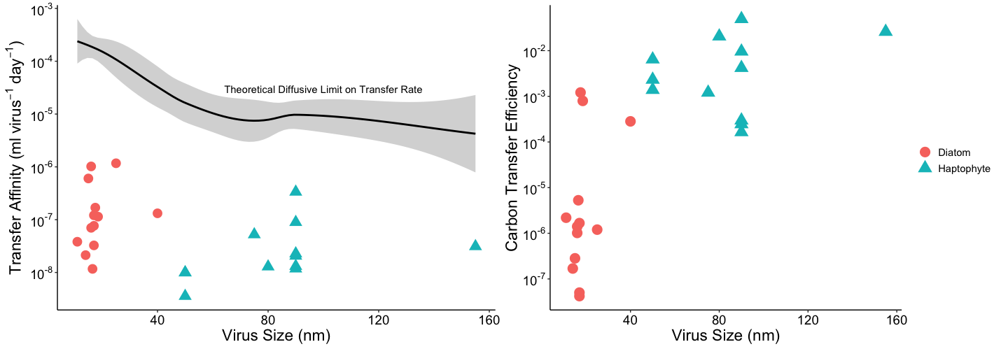
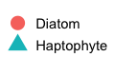
Transfer affinity decreases with virus size, perhaps due to reductions in diffusive encounter rate
Notes:
Small virus size leads to enhanced rate of encounter due to diffusion.. So why be large??
…Are other traits (e.g. lysis rate, burst size, etc) higher for larger viruses?

Slide 32
Small virus size leads to enhanced rate of encounter due to diffusion.. So why be a large virus??
…Are other traits (e.g. lysis rate, burst size, etc) higher for larger viruses?

Slide 33



Carbon transfer efficiency
Q_{v}- virus carbon quota (pmol C virus⁻¹)
Virus
β_{v} – burst size
Prey item
Q_{h}- host carbon quota (pmol C cell⁻¹)

Slide 34
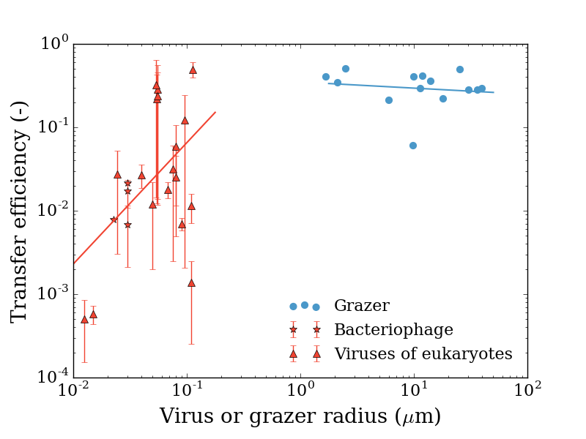
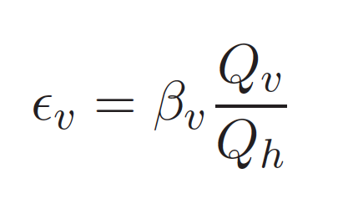
Carbon transfer efficiency is much lower for viruses than for microzooplankton grazers
Virus carbon quota
Burst size
Host carbon quota
Jover et al., Nat. Rev. Micr. (2014)
Talmy et al. Env. Micr., (2019)

Slide 35
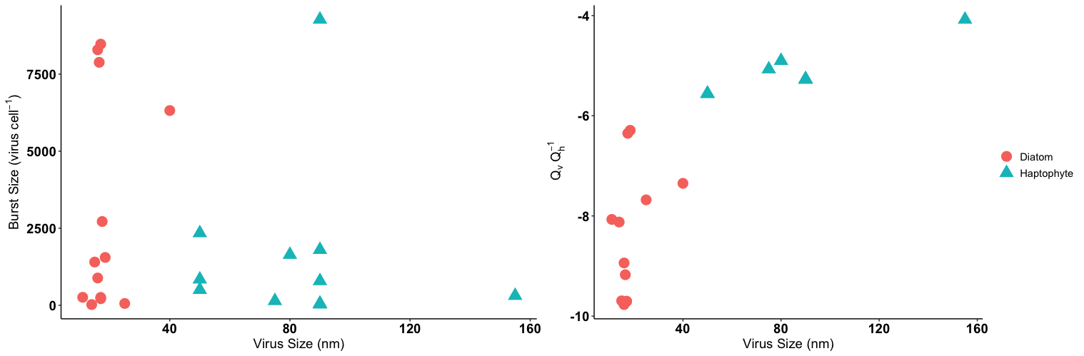
Carbon quotas from Jover et al., 2014; Menden-Deuer & Lessard, 2000
Model inferred burst size
Large spread in burst size with no clear trends.. But smaller viruses have much lower virus:host size ratio

Slide 36
Possible trade-off between transfer affinity (favoring small virus size) and carbon transfer efficiency (where large viruses have significant advantage)

Slide 37
Looking forward: placing viruses in biogeochemical context

Slide 38


Collaborators:
Rutgers University
Chana Kranzler
Kay Bidle
Jozef Nissimov
Kim Thamatrakoln
UTK
Priscilla Chao
Lucas Fiet
Margie Knight
Audra Hinson
Steve Wilhelm
website: www.talmygroup.com
email: dtalmy@utk.edu
github: https://github.com/dtalmy

Slide 39
What does the model add?
Light limitation:
alters E. huxleyi growth rate
doesn’t influence rate of host lysis
reduces EhV yield (burst size)
speeds up combined effects of adsorption, entry and replication

Slide 40
